Slide 1
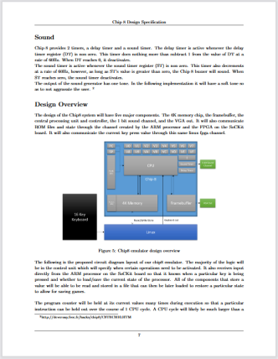
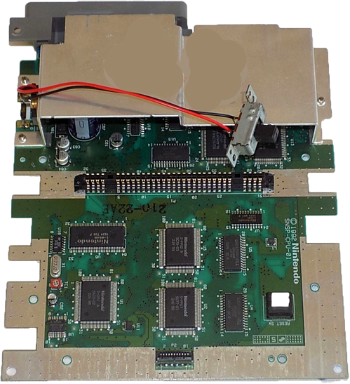
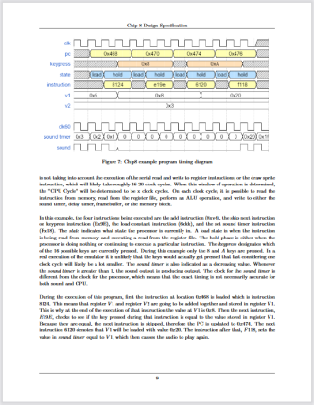
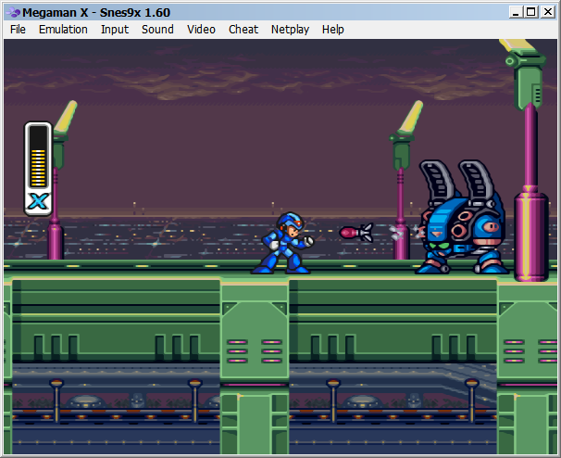
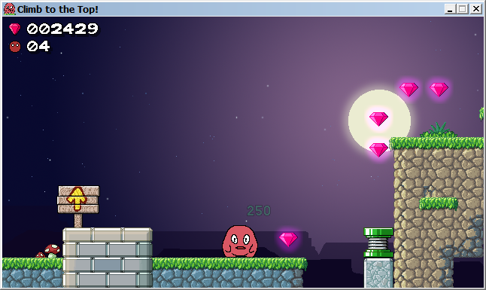
Physical machine
An already existing console
Emulated machine
A program that imitates a console
Made up machine
A new console created from scratch
How it works, and what it can do, are given by
its components
How it works is given by the
the original machine
How it works is given by its design documents

